Slide 1

ROAD SAFETY (TRAFFIC INCIDENTS)
GROUP – 5
AKARSHA HEGDE
ANSUMAN PATNAIK
BRUNDA ANANTHA

Slide 2
CONTENTS
Project Overview
Dataset Summary
Data Profile
Architecture Tool Blueprint (OLAP Model)
Final Architecture
Analysis and Visualisation
DEMO
RACI Chart

Slide 3

PROJECT OVERVIEW
Objective
Identify common causes of traffic collisions.
Determine high-risk locations and times for traffic accidents.
Examine factors contributing to collisions, such as weather, traffic control, and driver/pedestrian behavior.
Goal
Use data analysis to support traffic safety measures.
Inform policy decisions to reduce accidents and improve road safety.
Highlight trends that may indicate potential risk factors or areas for improvement.
Insights
Collision Patterns: Most common types of collisions, e.g., rear-end, angle, or single-vehicle crashes.
Risk Factors: Factors that increase the risk of collisions, including weather, traffic control, driver substance abuse, or distracted driving.
High-Risk Locations: Locations with a high frequency of collisions.
Injury Severity: Trends in the severity of injuries and factors contributing to serious or fatal injuries.
Datasets
Motor Vehicle Drivers Dataset
Non-Motorists (Pedestrians and Cyclists) Dataset

Slide 4
DATASET SUMMARY
Dataset | Crash Reporting - Drivers Data | Non-Motorists (Pedestrians and Cyclists)
Source | Montgomery County Police, Maryland State Police's Automated Crash Reporting System (ACRS). DATA GOV | Same as Dataset 1, DATA MONTGOMERY
Description | Information on motor vehicle operators (drivers) involved in traffic collisions on county and local roadways. | Information on non-motorists (pedestrians and cyclists) involved in traffic collisions on county and local roadways.
Rows & Columns | Total Rows: 172k Total Columns: 43 | Total Rows: 5,650 Total Columns: 32
Access | File Type: API Call Location: Online, downloadable from a specified URL (https://data.montgomerycountymd.gov/Public-Safety/Crash-Reporting-Drivers-Data/mmzv-x632/about_data). | File Type: CSV Location: Online, downloadable from a specified URL (https://data.montgomerycountymd.gov/Public-Safety/Crash-Reporting-Non-Motorists-Data/n7fk-dce5/about_data)
Data Quality | Clean, Well maintained and consistent | Clean, Well maintained and consistent

Slide 5
DATA PIPELINE (Waterfall Model)
Data Source
Data Collection
Data Preprocessing
Storage (Data Warehouse)
Analysis & Business Insights

Slide 6
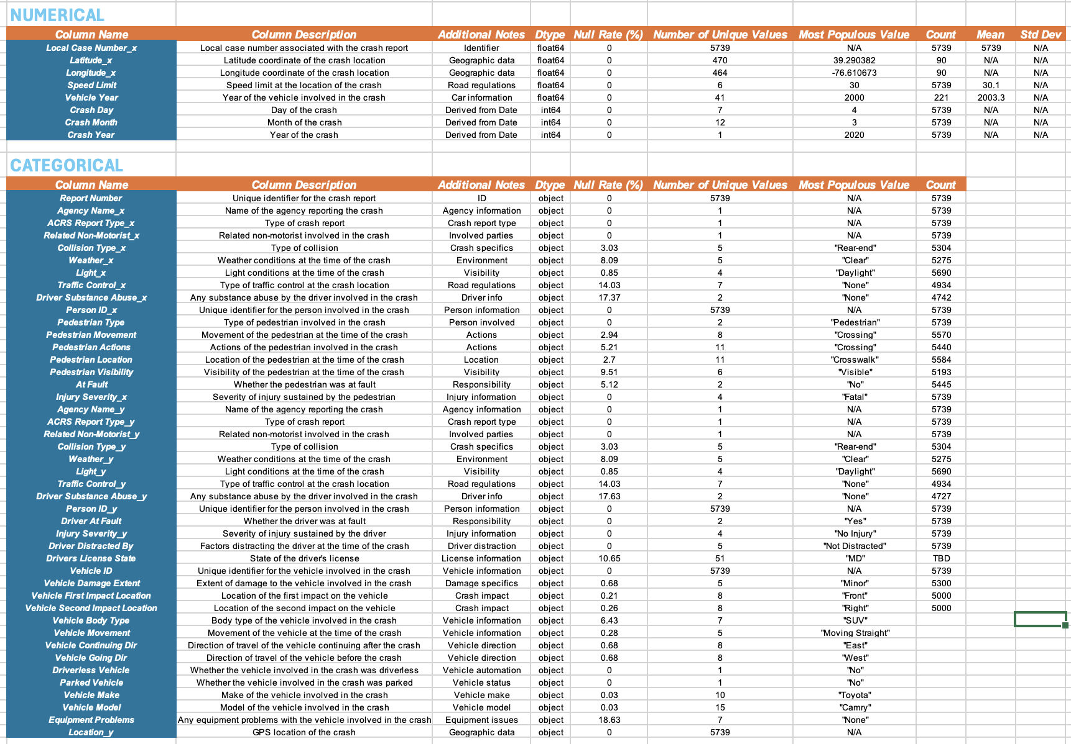
DATASET PROFILING
Dataset Profiling File

Slide 7
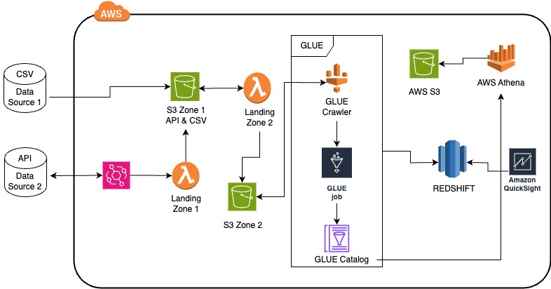
PRE-PLANNED ARCHITECTURE

Slide 8
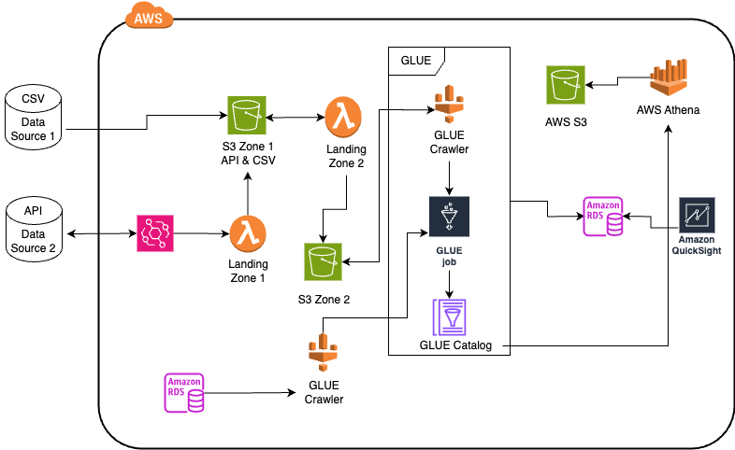
FINAL ARCHITECTURE

Slide 9
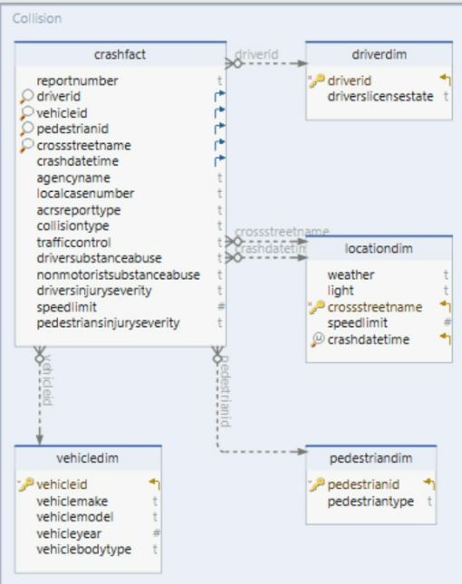
DATA MODEL
FACT TABLE
crashfact
DIMENSION TABLE
driverdim
vehicledim
locationdim
pedestriandim

Slide 10
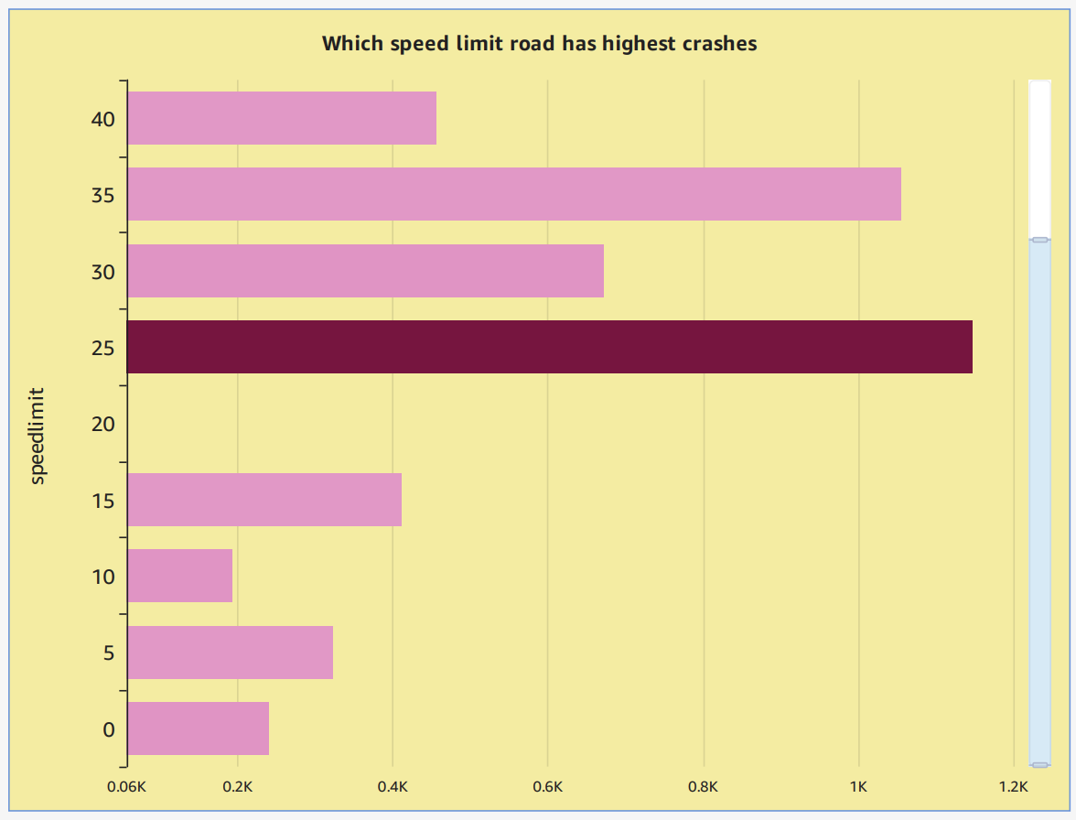
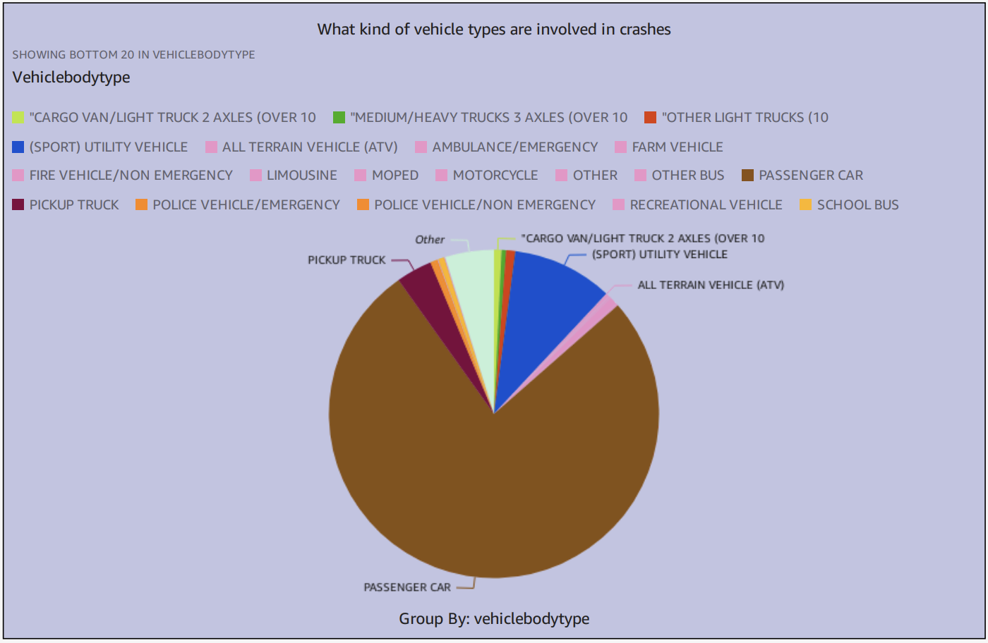
ANALYTICS

Slide 11
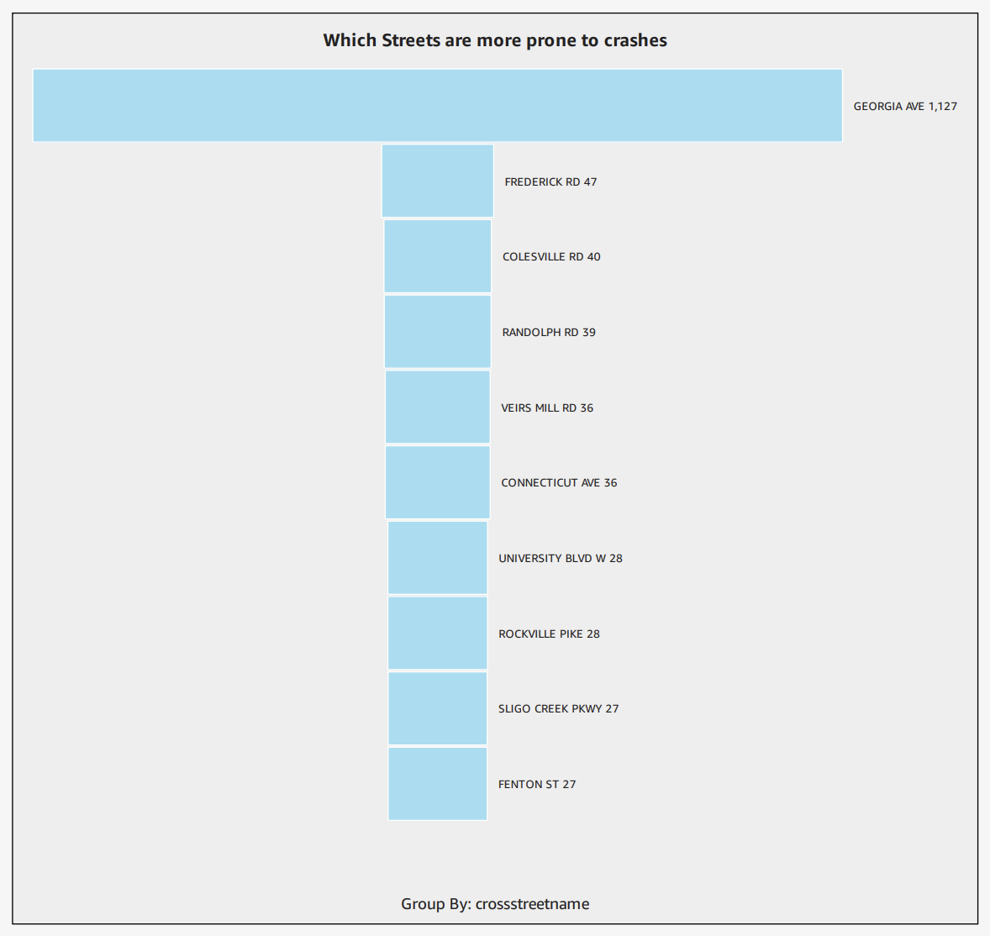
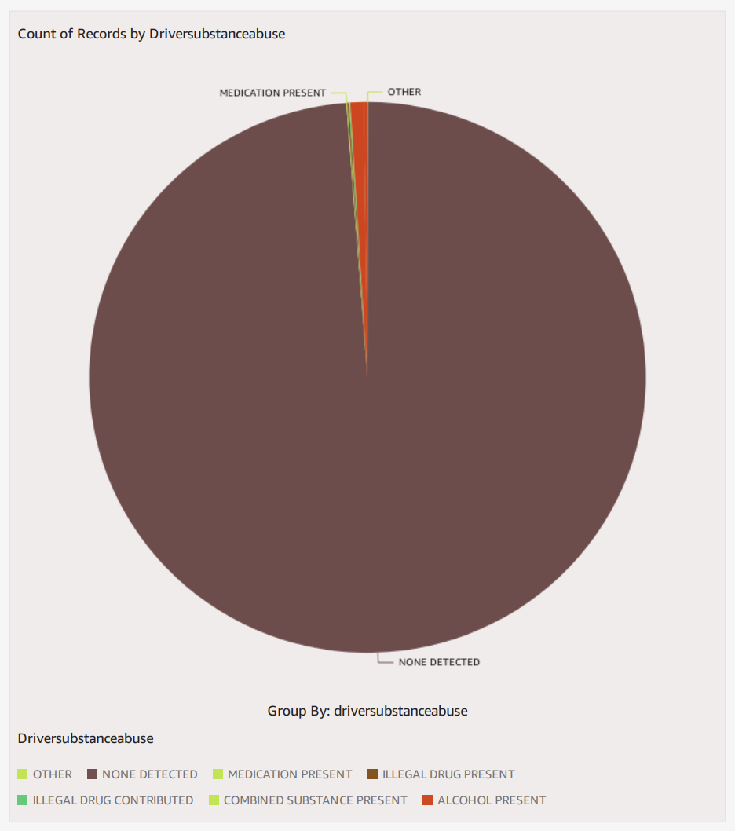
ANALYTICS
Did the driver have any substantial abuse?

Slide 12
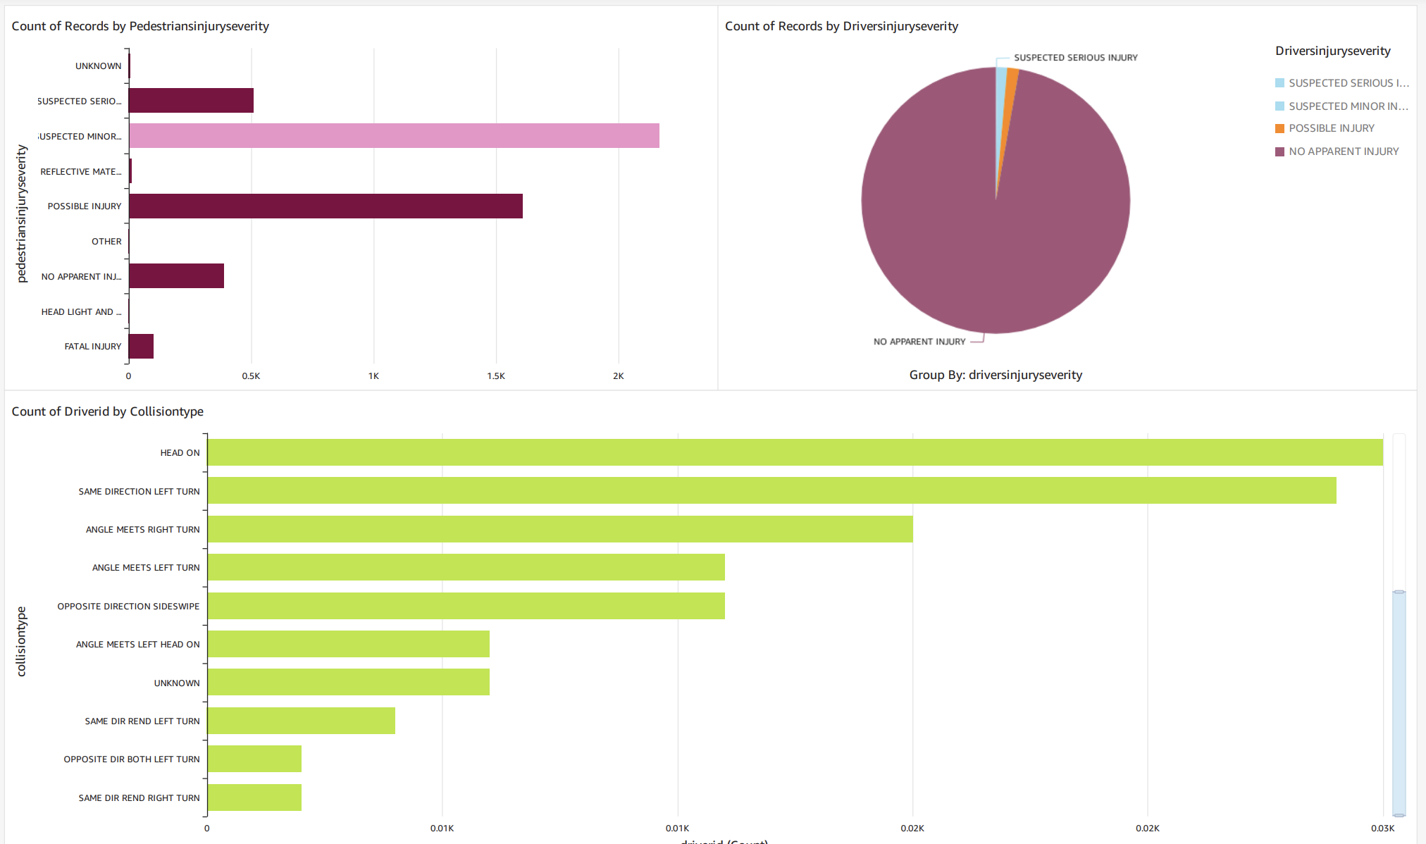
ANALYTICS
Are there more drivers or pedestrians seriously injured in accidents?
What is the most common type of traffic accident?

Slide 13

DEMO

Slide 14
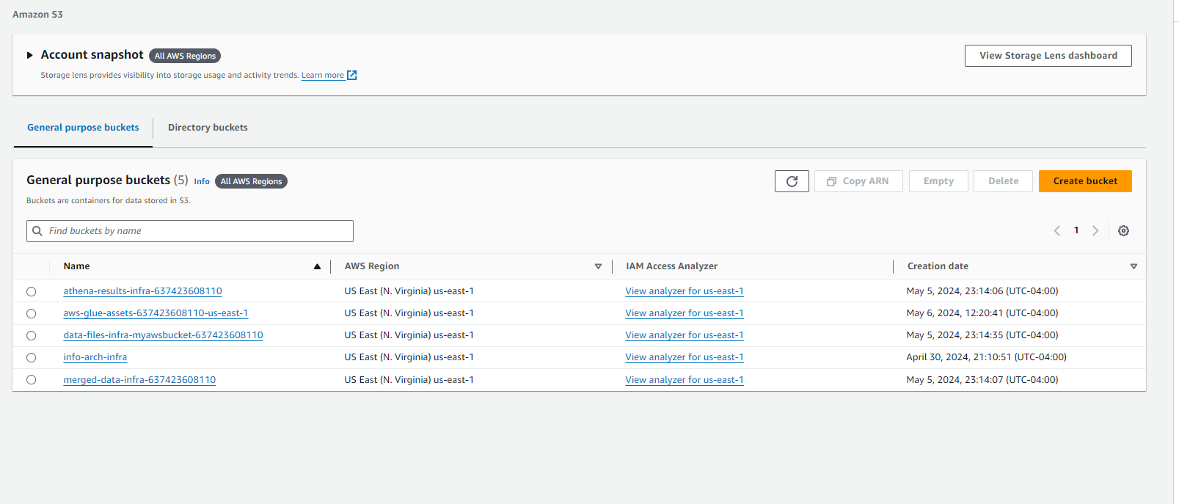
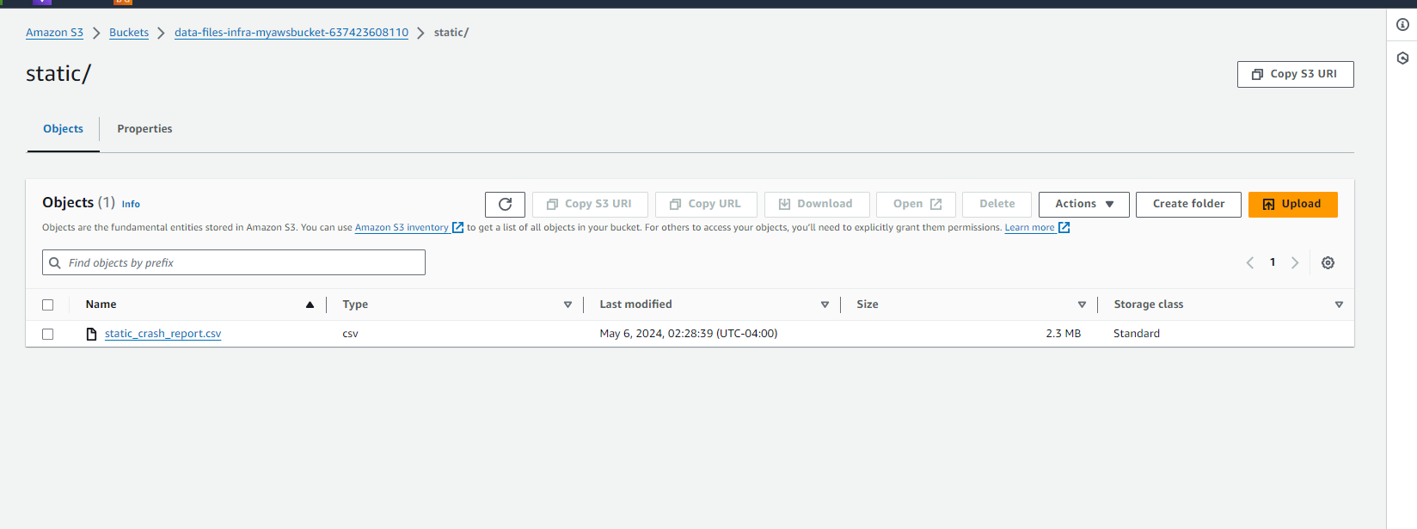
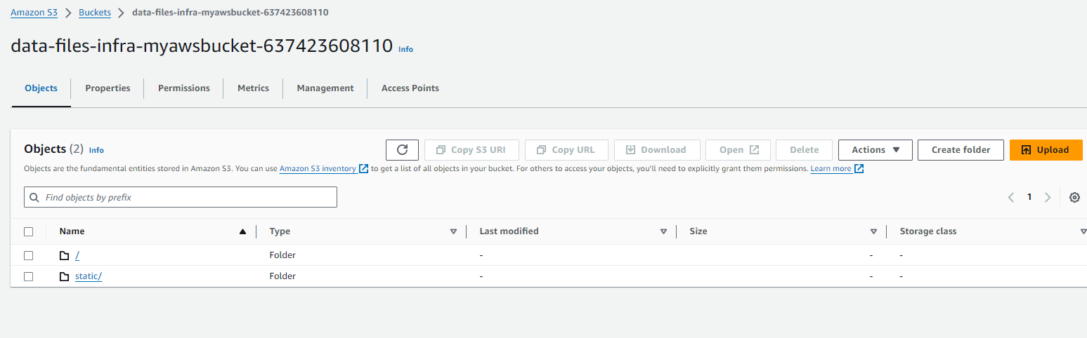
S3 BUCKET

Slide 15
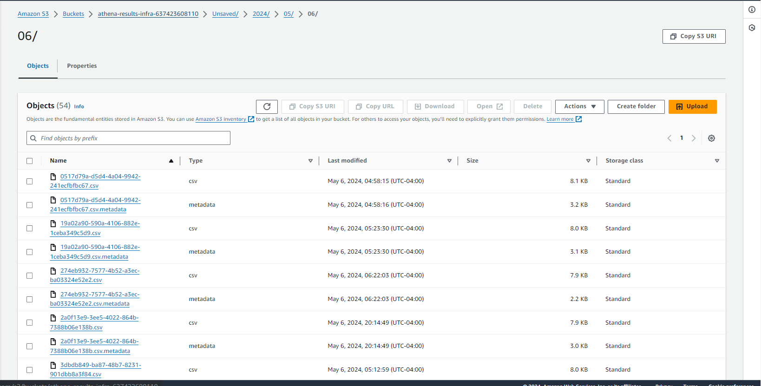
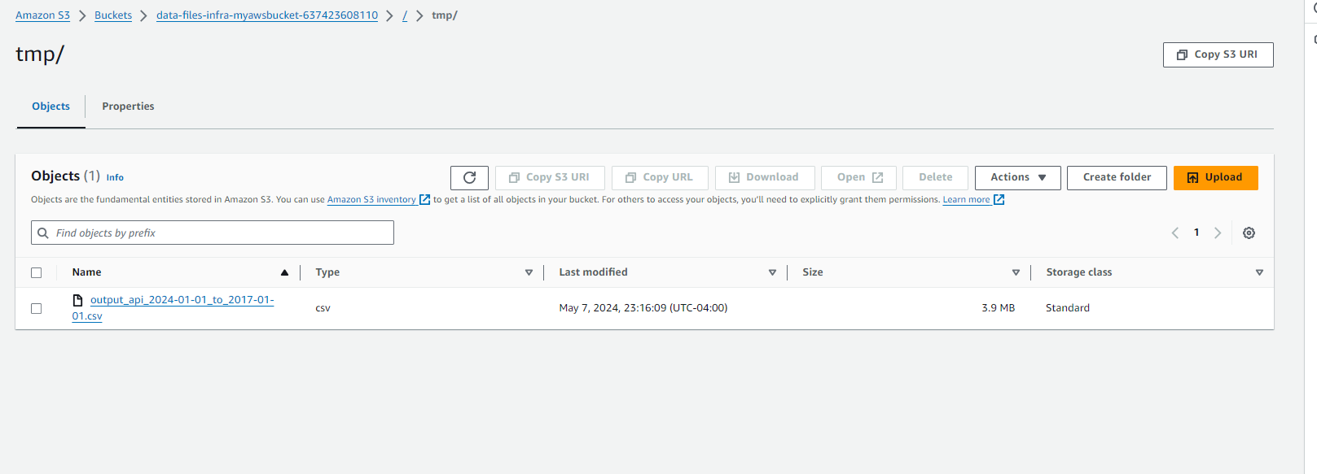
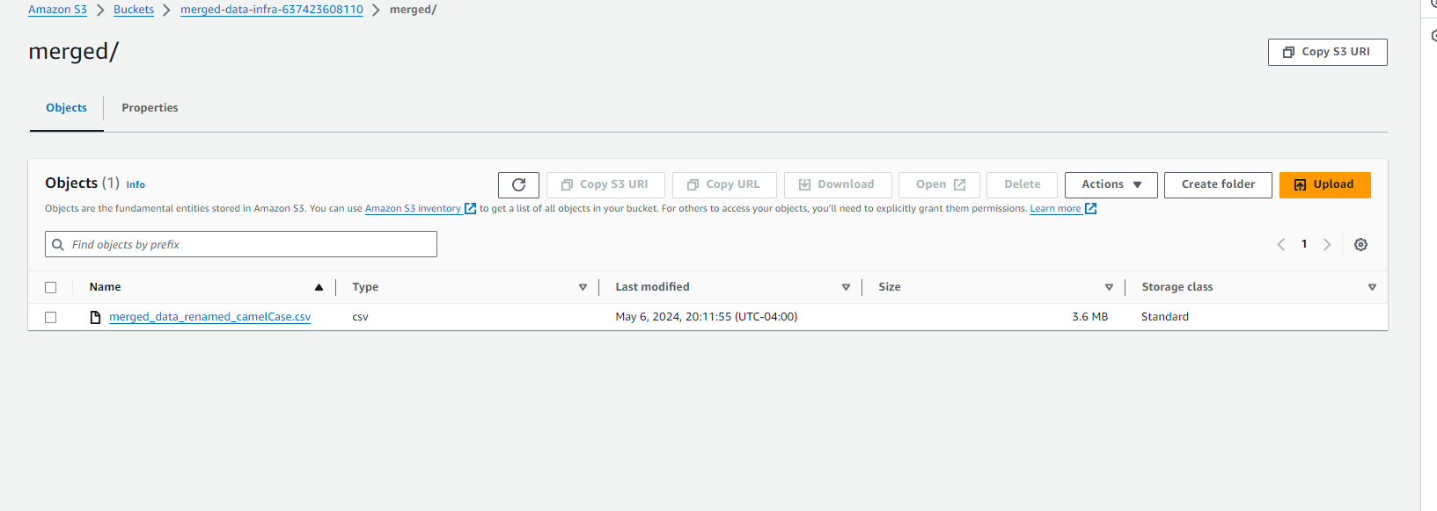
S3 BUCKET

Slide 16
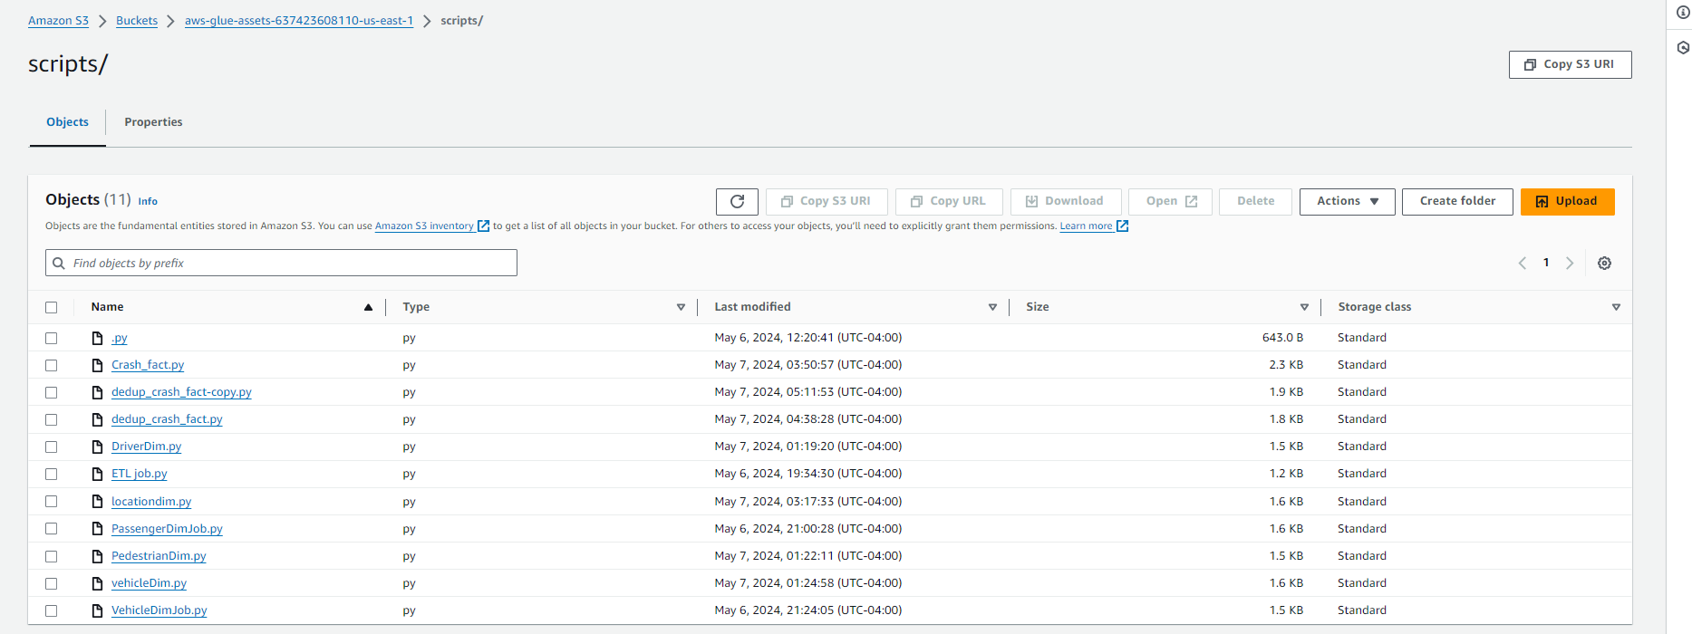
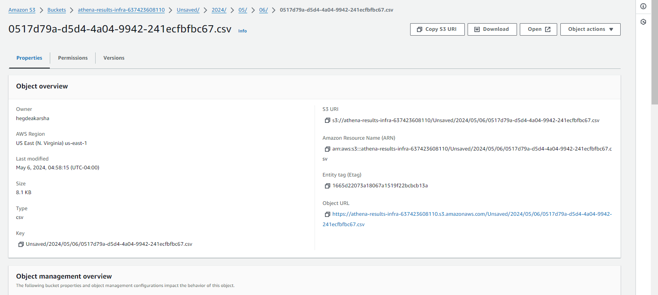
S3 BUCKET

Slide 17
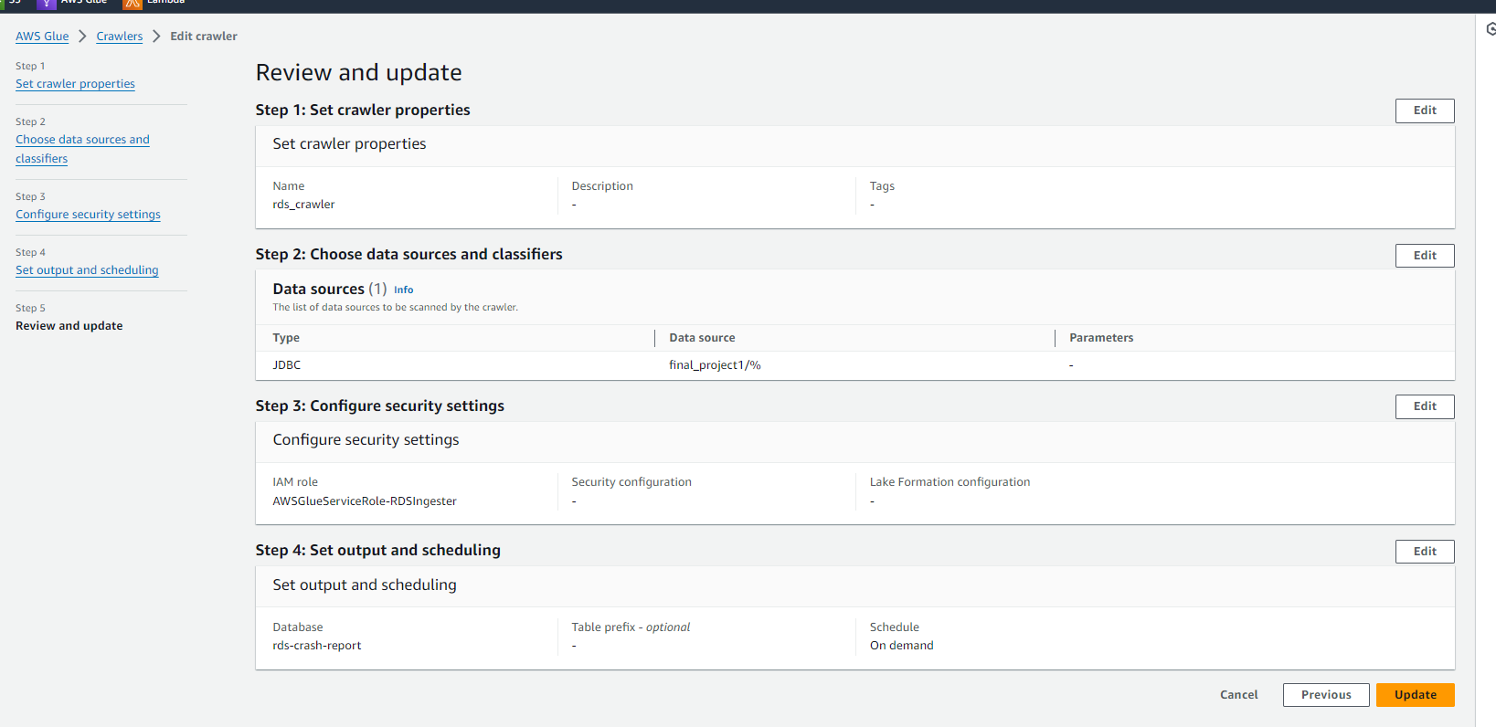
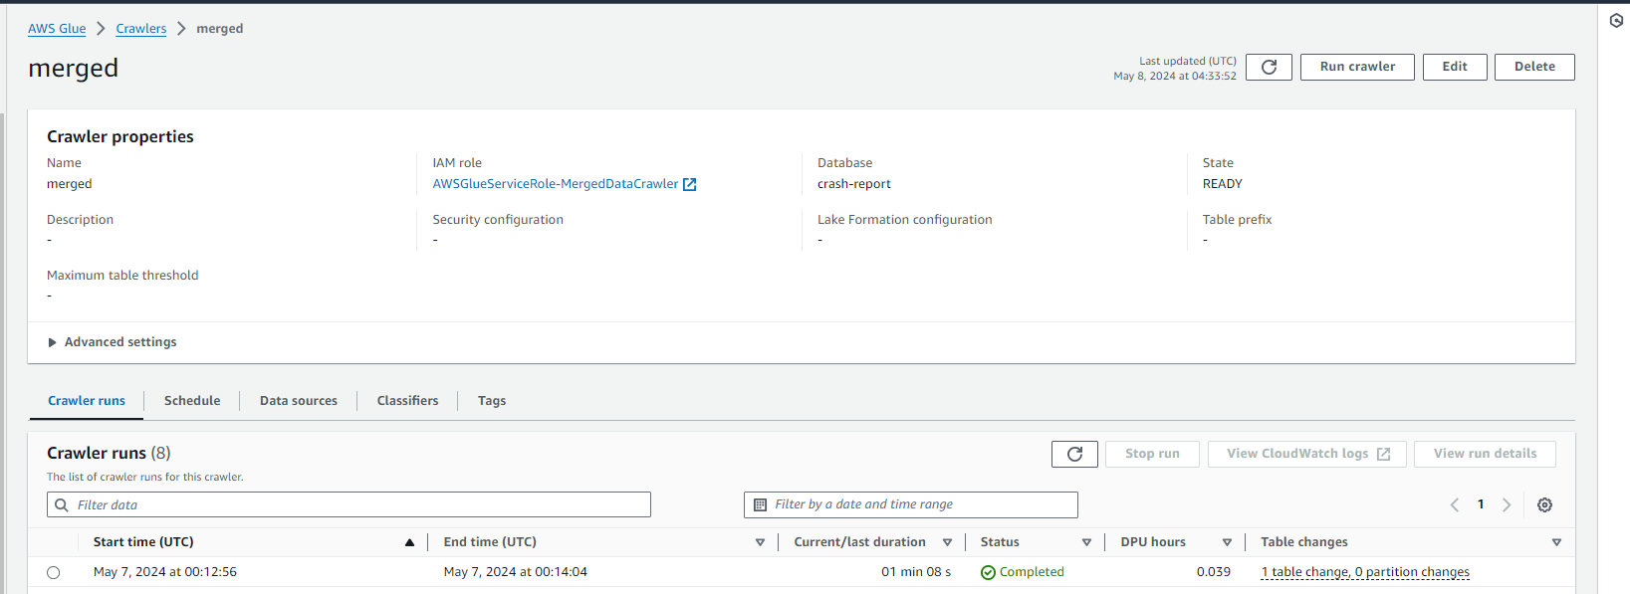
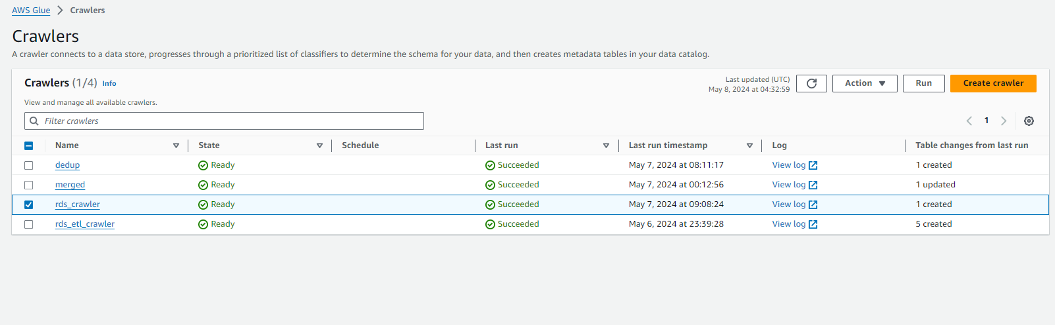
GLUE CRAWLER

Slide 18
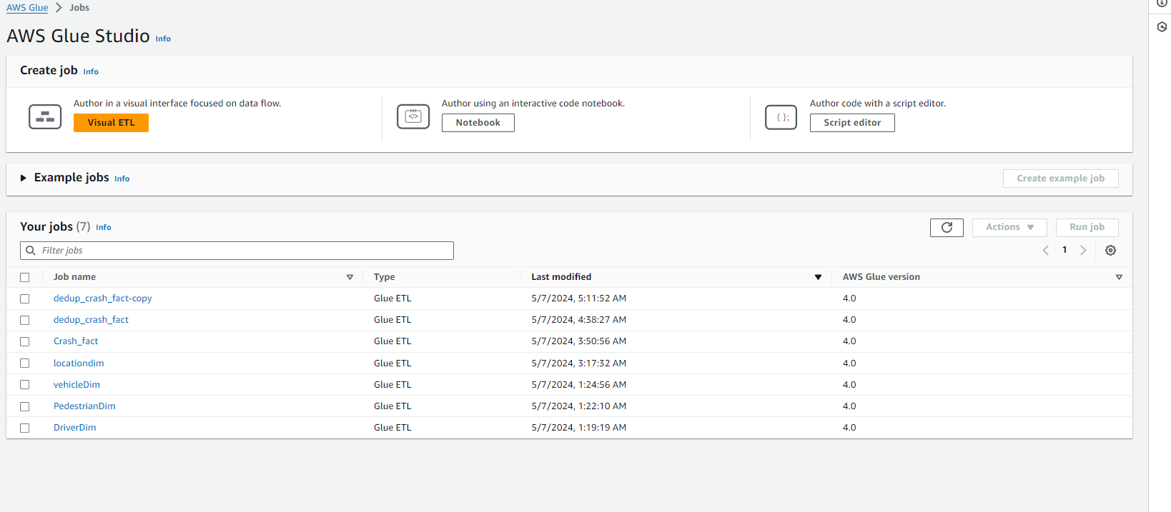
GLUE JOB

Slide 19
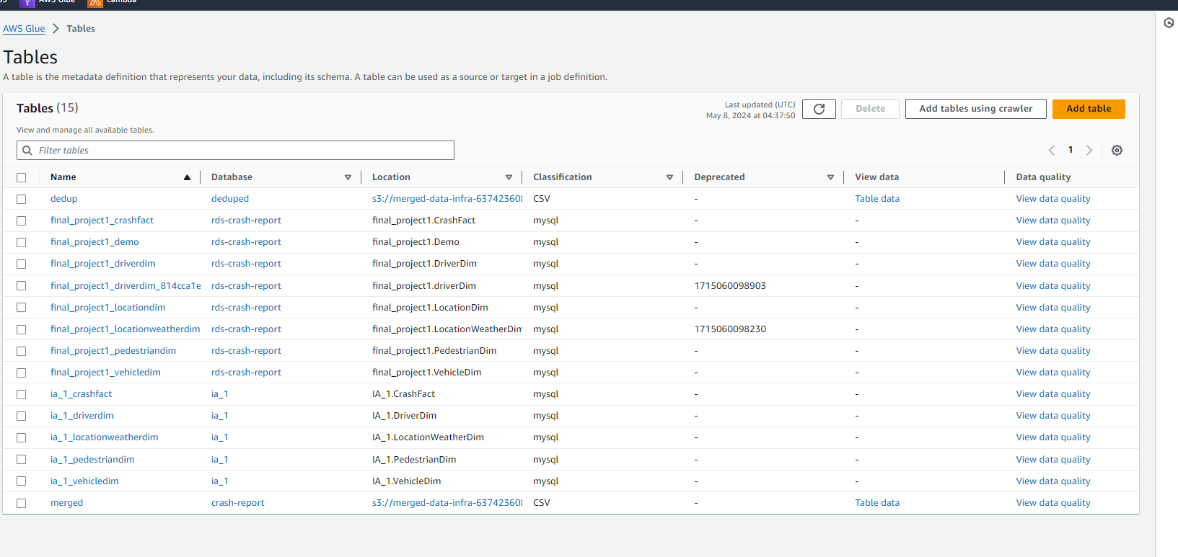
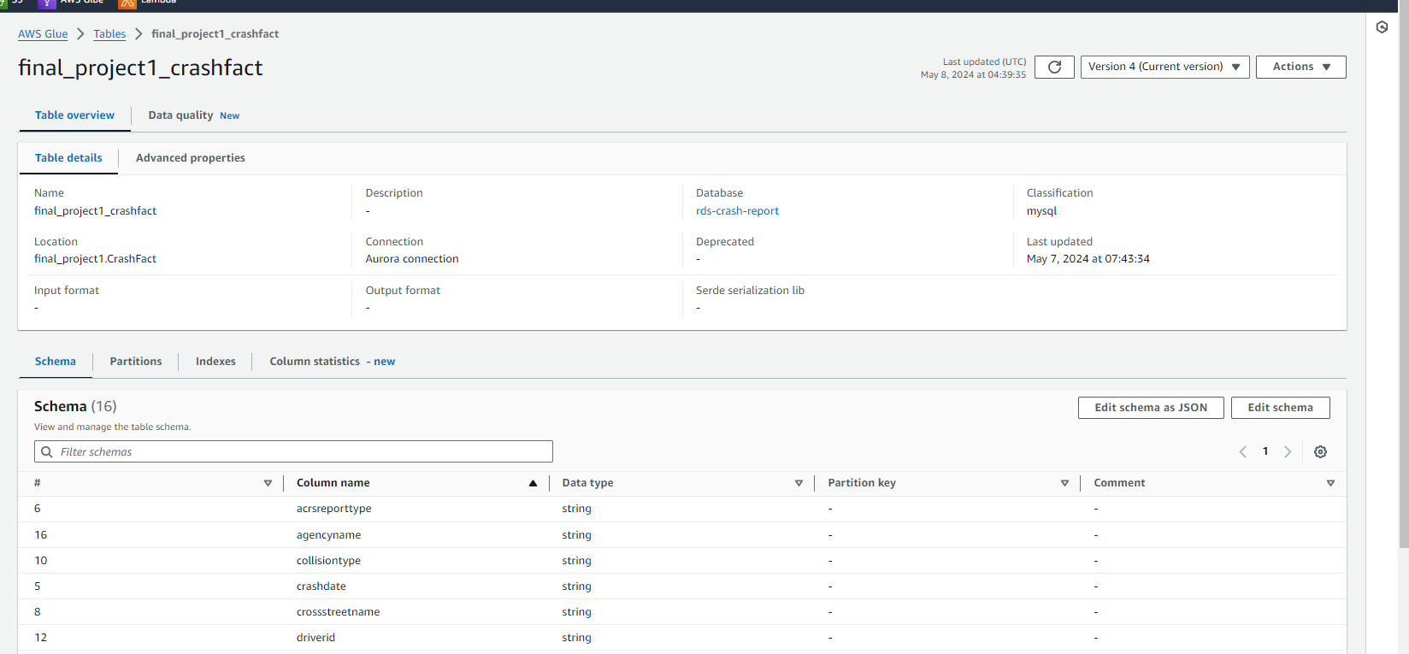
GLUE JOB TABLES

Slide 20
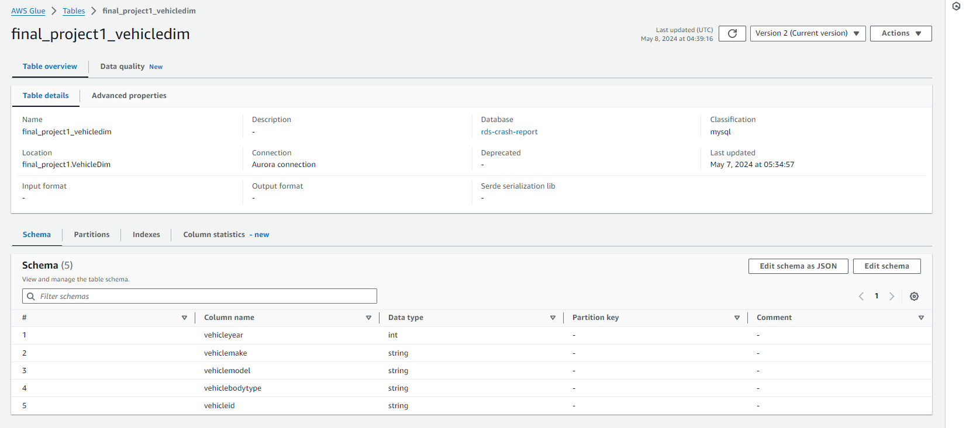
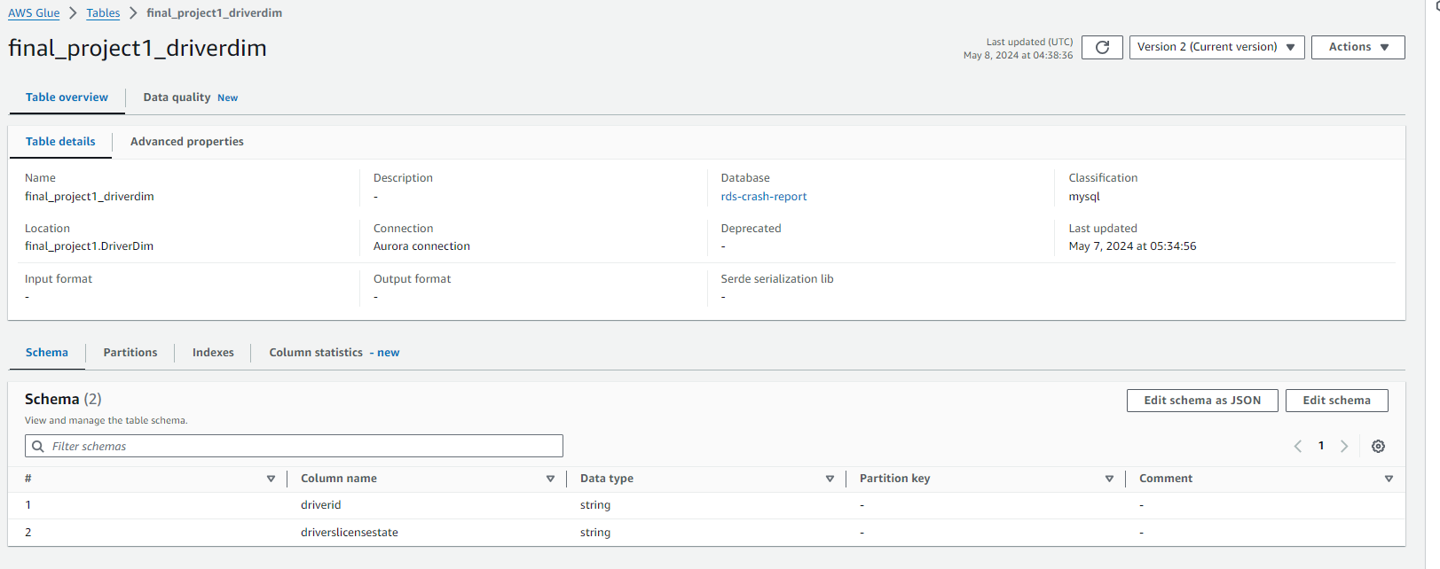
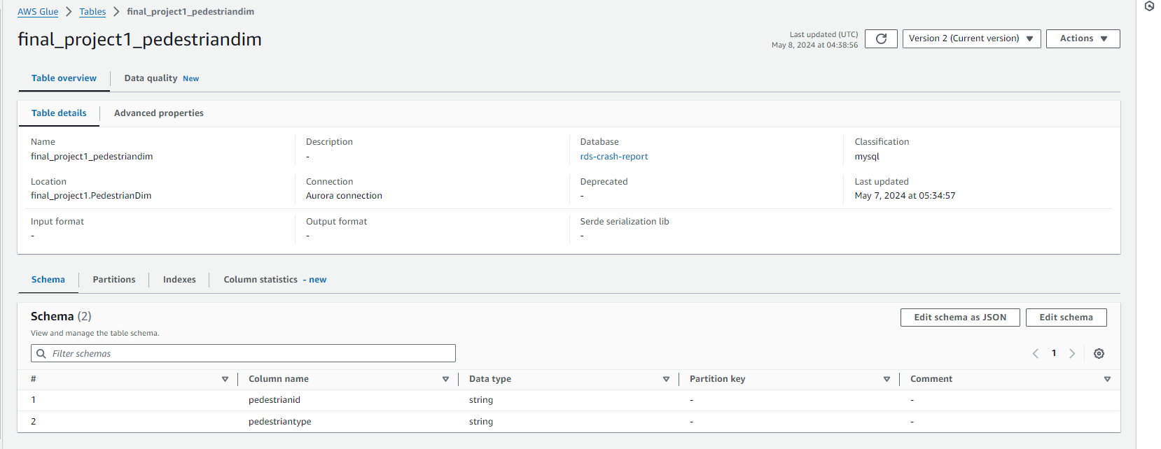
GLUE JOB TABLES

Slide 21
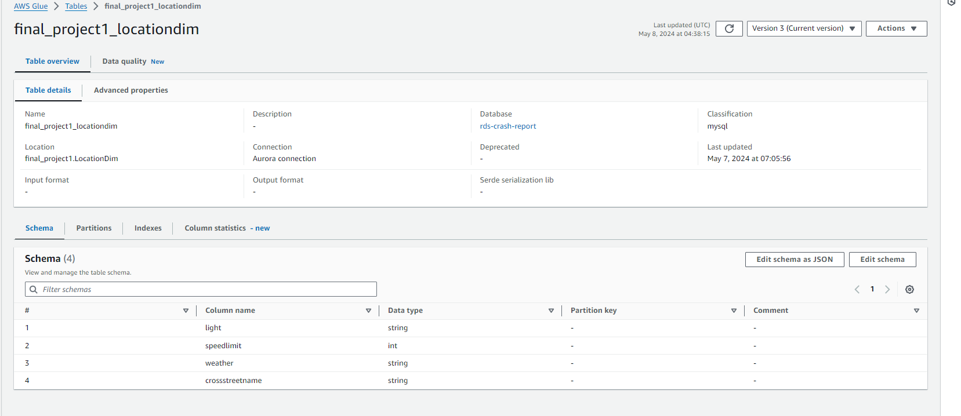
GLUE JOB TABLES

Slide 22
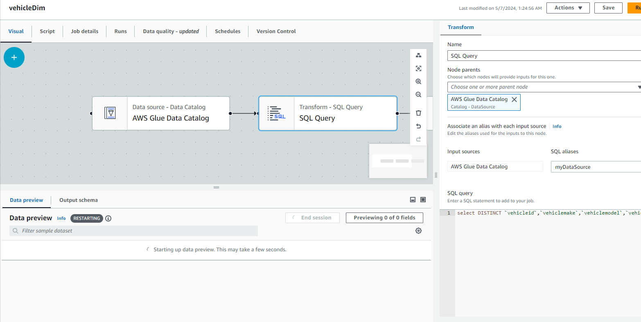
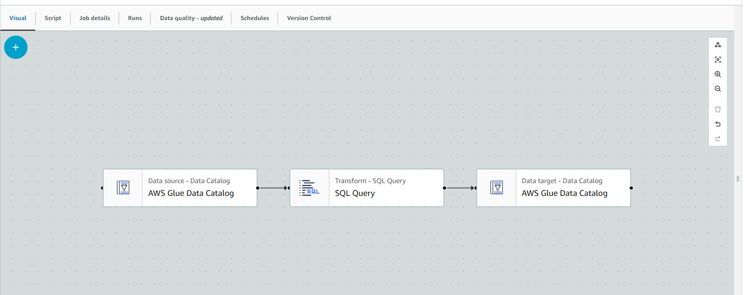
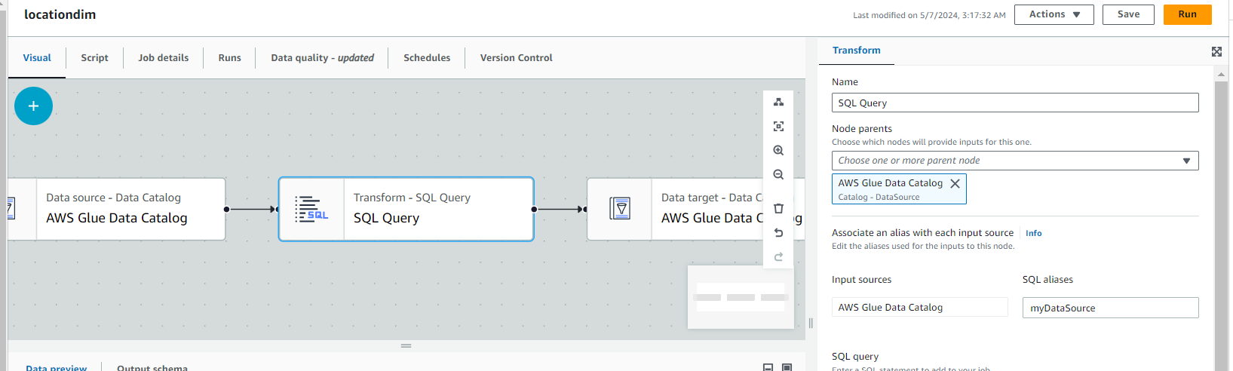
GLUE JOB ETL

Slide 23
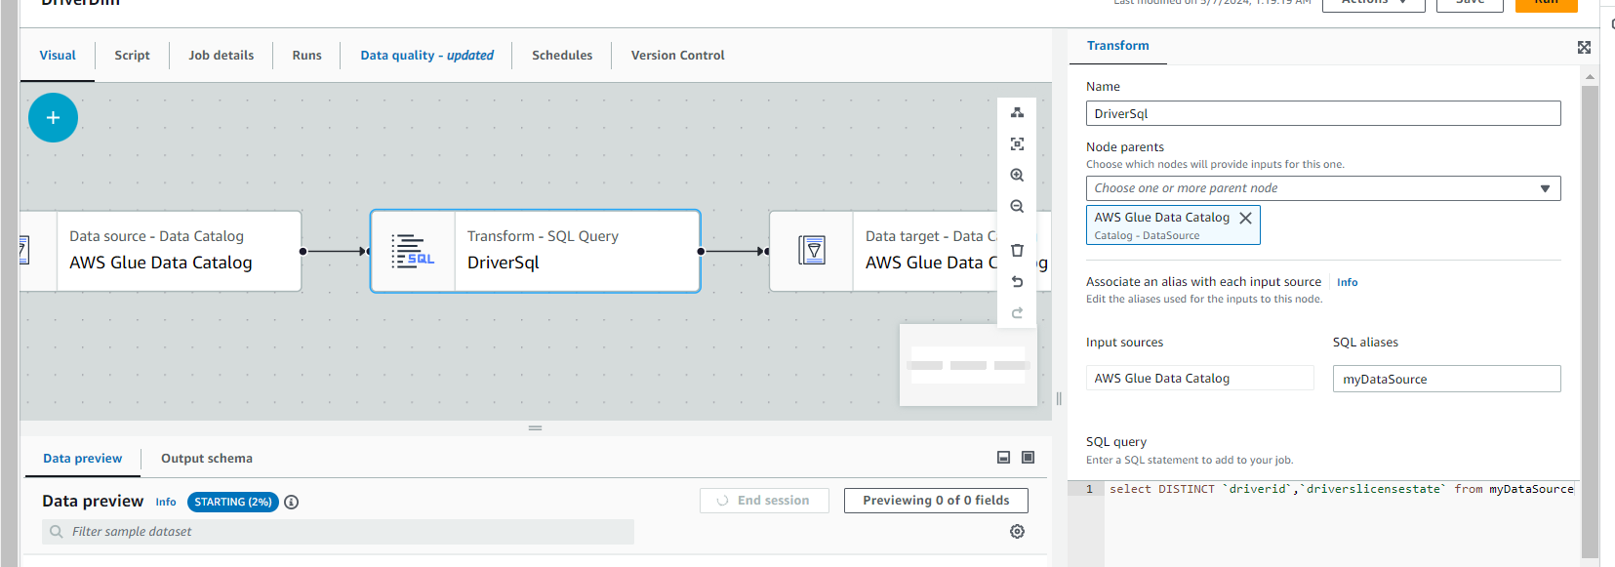
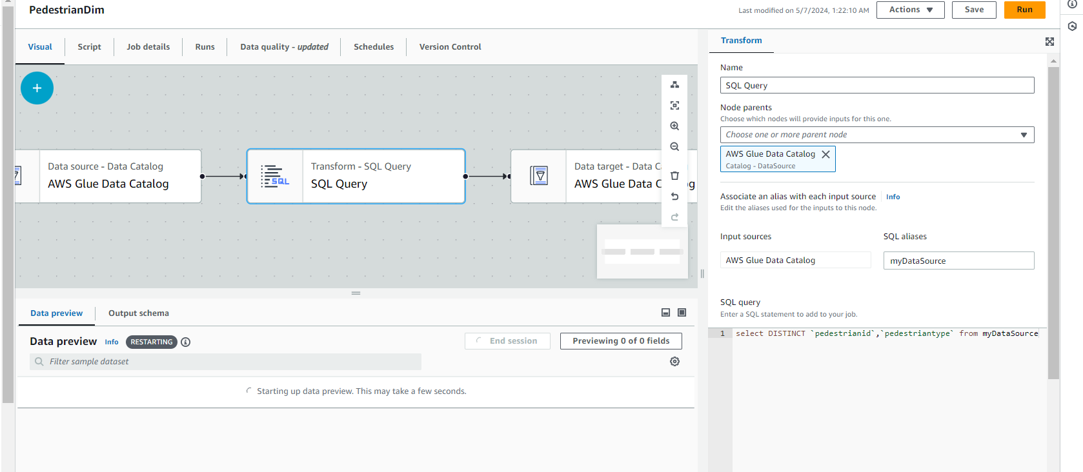
GLUE JOB ETL

Slide 24
RACI CHART
Group 5
Topic | Road Safety Insights (Montgomery)
Task | ANSUMAN | AKARSHA | BRINDA | Timeline | Status | Task Done By |  | R | Responsible
Overseeing entire project | R | I | I | On-Time | Done | Ansuman |  | A | Accountable
Acting as liaison & Maintain RACI | R | I | I | On-Time | Done | Ansuman |  | C | Consulted
Data Pre-process | C | I | R | On-Time | Done | Brinda |  | I | Informed
Data Profiling | R | I/C | I | On-Time | Done | Ansuman |  | I
Data Modelling | C/I | R | A | On-Time | Done | Akarsha
Conceptual modelling | C/I | R | A | On-Time | Done | Akarsha
ER Diagram | I | C | R | On-Time | Done | Brinda
Designing AWS Extraction | A/I | R | C | On-Time | Done | Akarsha
AWS Transform | R | C | C/I | Delayed | Done | Ansuman
AWS Load | C | R | C/I | Delayed | Done | Akarsha
Physical Layout | R | C | C | On-Time | Done | Ansuman
Managing data transformation | C | R | C | On-Time | Done | Akarsha
Managing data loading | C | R | I | On-Time | Done | Akarsha
Collaborating with database architect for data warehousing | C | R | C | On-Time | Done | Akarsha
Designing data warehouse schema | R | C | I | Delayed | Done | Ansuman
Visualization | I | R | C/I | Delayed | Done | Akarsha
Reporting & Presentation | R | C/I | C/I | Delayed | Done | Ansuman

Slide 25

THANK YOU

